Slide 1
CGB1201 – JAVA PROGRAMMING
Department of Artificial Intelligence and Data Science
Academic Year: 2024 – 2025 (Odd Semester)
Register Number :2303811724322073
Name :Muthu Meena K
Year :II
Semester :III
Section :B
Date :03/12/24

Slide 2
Title of the Project
CALCULATOR

Slide 3
Abstract
This Java program implements a scientific calculator that can handle both basic and scientific operations.
The calculator provides a user interface where users can choose between basic arithmetic operations (+, -, *, /) and scientific functions (e.g., sine, cosine, tangent, exponential, logarithm, square root).

Slide 4
Introduction
The Scientific Calculator program in Java is designed to provide users with an easy-to-use interface for performing both basic arithmetic operations and scientific calculations.
It supports a wide range of mathematical functions, including addition, subtraction, multiplication, division, trigonometric functions (such as sine, cosine, and tangent), exponential calculations, logarithms, and square roots.
This tool is useful for performing complex calculations while also offering the simplicity required for everyday arithmetic.

Slide 5
Java Programming - Concepts Used
AWT (Abstract Window Toolkit)
Event Handling in AWT

Slide 6
Proposed Architecture
START
DISPLAY MENU
BASIC
SCIENTIFIC
INPUT (numbers and operators)
PERFORM CALCULATION
INPUT(number and functions)
EXIT
END
EXIT

Slide 7
Proposed Architecture - Description
Basic Mode:
Input: The user enters numbers and arithmetic operators (like +, -, *, /) for basic calculations.
Perform Calculation: The calculator processes the input and performs the specified calculation.
End: The result of the calculation is displayed, and the user can choose to perform another calculation or exit the application.

Slide 8
Proposed Architecture - Description (Cont..)
Scientific Mode:
Input: The user enters numbers and mathematical functions (like trigonometric functions, logarithms, exponentials, etc.) for advanced calculations.
Perform Calculation: The calculator processes the input and performs the requested scientific calculation.
End: The result of the calculation is displayed, and the user can choose to perform another calculation or exit the application.

Slide 9
List of Modules
Basic Operations Handling Module
Scientific Operations Handling Module

Slide 10
Module Description
Basic Operations Handling Module
The Basic Operations Module is responsible for performing fundamental arithmetic calculations such as addition, subtraction, multiplication, and division.
It allows the user to perform simple mathematical operations using two numbers and an operator.
The module also handles error conditions like division by zero and invalid operator input.

Slide 11
Module Description (Cont..)
Scientific Operations Handling Module
The Scientific Operations Module allows the user to perform more advanced mathematical calculations beyond basic arithmetic.
This includes trigonometric functions (sin, cos, tan), exponential functions (exp), logarithms (log).
The module takes a single number as input and applies the requested function.
It also provides error handling for invalid inputs (e.g., non-positive values for logarithms or negative values for square roots).

Slide 12
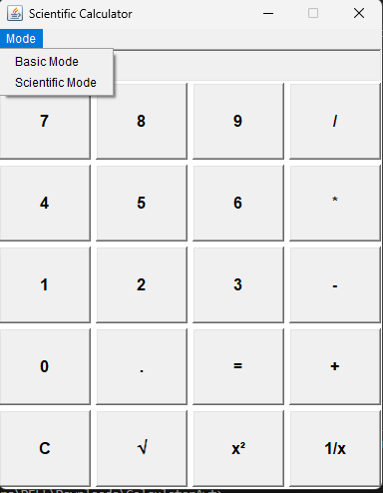
Results and Discussion

Slide 13
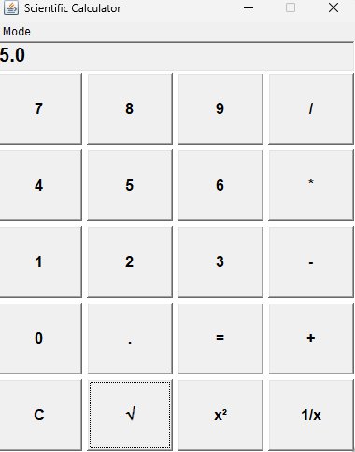
Results and Discussion (Cont..)
Basic Operations Handling Module

Slide 14
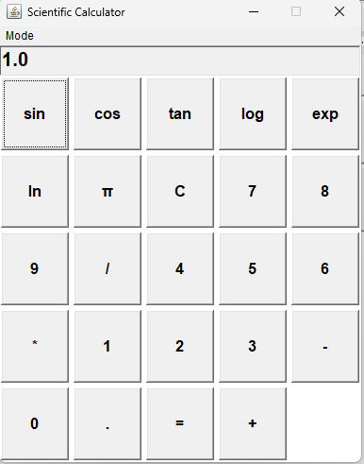
Results and Discussion (Cont..)
Scientific Operations Handling Module

Slide 15
Conclusion
The Scientific Calculator program in Java successfully combines basic arithmetic and advanced scientific calculations in a single interactive application.
It allows users to perform operations like addition, subtraction, multiplication, division, as well as trigonometric, logarithmic, and square root calculations.
Overall, the program serves as a reliable and user-friendly tool for performing a wide range of mathematical operations.

Slide 16
Thank You

